Slide 1
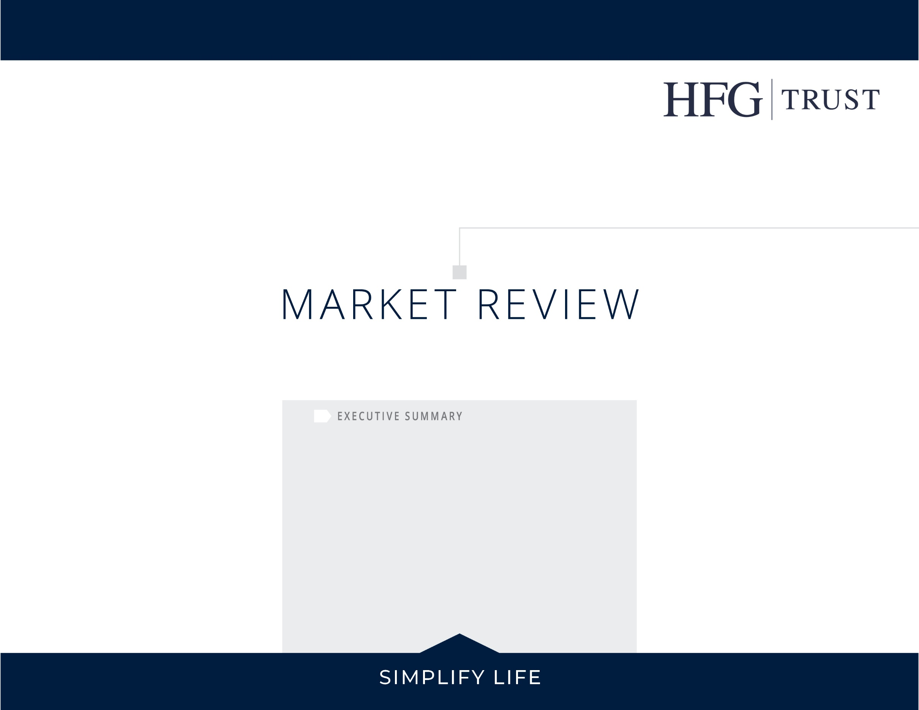
1st QUARTER 2026
The S&P 500 Index declined -4.4% in Q1, but the headline masked broad underlying strength. The equal-weighted S&P 500 gained +0.7%.
Large-Cap Value rose +3.3%, and Small- and Mid-Cap added +0.9%, as the shift toward smaller and more value-oriented companies continued. In contrast, Large-Cap Growth declined -10.4% and the Nasdaq fell -5.8% as technology stocks came under pressure.
International stocks outperformed the S&P 500 for a third consecutive month, with Developed Markets and Emerging Markets remaining flat.
Bonds dropped in February only to increase just as rapidly in March with the 10-year treasury yield finishing at 4.32%.

Slide 2

Quarterly Market Review
The Case for Diversification: Protecting Wealth in an Uncertain World
In his 1994 letter to Berkshire Hathaway shareholders, Warren Buffett cautioned against the dangers of excessive risk and overconfidence, noting, "Only when the tide goes out do you discover who's been swimming naked."
As history has taught, it is impossible to accurately forecast the precise timing of economic downturns or geopolitical conflicts. Rather, the most prudent course of action is to construct a portfolio prepared for a variety of market environments.
In moments like these, before the tide recedes, the goal is to ensure that no single outcome can undo everything you’ve built.
Overview:
  Market Summary
  Global Valuations
  US Stocks
  International Developed Stocks
  Emerging Markets Stocks
  Fixed Income
  REITs
William Wang, CFP®
Chief Executive Officer
This is why diversification remains a foundational risk-management strategy.
Market contractions have historically been a natural component of the financial cycle, frequently triggered by anticipated economic fear, sudden policy shifts and supply-chain disruptions that can rapidly alter market leadership. The current volatility in energy markets serves as a timely reminder that these shifts often arrive without warning.
As a result, prudent investors should exercise caution when investment strategies advocate for heavy concentration in emerging trends or encourage overexposure following a sector's recent outperformance. Chasing market momentum frequently results in acquiring assets at peak valuations, thereby maximizing exposure precisely when the risk of a reversal is highest.
Ultimately, while diversification cannot guarantee positive returns, it remains the most reliable defense against market unpredictability. Sound wealth management is embodied by diligent preparation and prudent asset allocation, ensuring that portfolios are positioned to withstand the inevitable shifts in the economic tide.

Slide 3
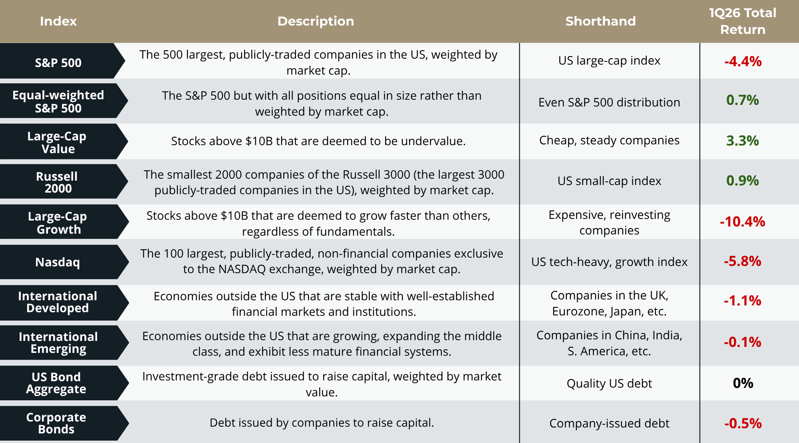
Quarterly Market Review
The Case for Diversification: Protecting Wealth in an Uncertain World
The first quarter was eventful for markets.
Stocks traded higher to start the year, with the S&P 500 posting a modest gain in January. However, the market traded lower in March amid a spike in oil prices.
The S&P 500 returned -4.4%, but there were bright spots, despite the late-quarter volatility. The average S&P 500 stock outperformed the broad index by nearly +5% as market leadership broadened, and manufacturing data showed signs of improvement.
In January, crude oil gained nearly 13% as supply concerns related to Venezuelan output and Middle East tensions began to build. Prices increased another +4% in February, before sharply accelerating in March. The U.S.-Iran conflict and the closure of the Strait of Hormuz—a chokepoint for roughly 20% of global oil flows—sent crude oil prices surging nearly +50% in a single
month. By quarter-end, oil prices had risen more than +70% overall.
Rising oil prices coupled with the risk of renewed inflation pressure led to a shift in rate cut expectations. At the start of 2026, investors anticipated two to three rate cuts by year-end. Those expectations, however, were steadily priced out over the course of the quarter, with the possibility of a rate hike being discussed as oil prices spiked in March.

Slide 4
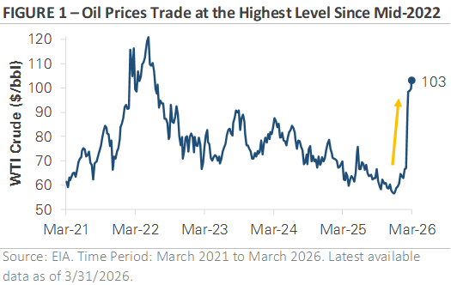
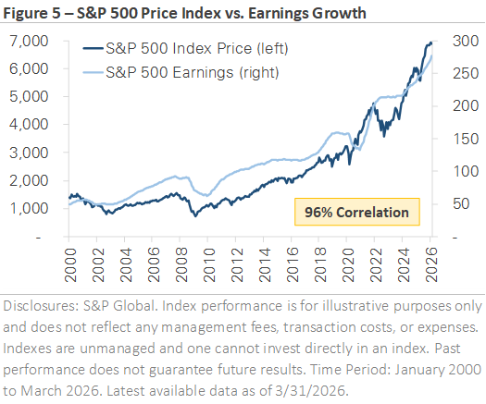
Quarterly Market Review
The Case for Diversification: Protecting Wealth in an Uncertain World
Looking ahead, the situation remains fluid. Oil is trading near $100 per barrel, suggesting the market expects ongoing disruption, while developments in the Middle East will likely continue to influence short-term market direction.
The key development to watch in the coming months is the situation in the Middle East and its impact on oil prices. The Strait of Hormuz was still closed at quarter-end, with negotiations ongoing. Progress toward a resolution would likely ease energy costs and reduce inflation pressures, giving the Federal Reserve more flexibility on interest rate policy. A prolonged disruption would give higher oil prices more time to work their way through to the economy, potentially affecting consumer spending and business investment while keeping inflation elevated.
Ultimately, the relationship between oil prices, inflation, and Federal Reserve policy remains a key thread. Upcoming inflation data will be the first reports to capture the full impact of higher energy costs, and how those readings come in will shape the outlook for interest rates and the broader economy.
While the market's decline in Q1 drew attention, it's worth stepping back to look at the bigger picture. Figure 2 shows the relationship between the S&P 500's price and its earnings over the past 26 years. The two have moved together with a 96% correlation. When earnings rise, stock prices generally follow. When earnings decline, as they did during the 2001 recession, the 2008 financial crisis, and the 2020 pandemic, stock prices tend to fall.
What stands out about the current environment is that earnings estimates have continued to rise even as the S&P 500 has pulled back. Profit margins remain healthy, and analysts still expect earnings growth in the coming quarters. The market's decline has been driven by uncertainty around oil prices, inflation, and Fed policy, not by a deterioration in the fundamentals that drive stock prices over time.
That distinction is important for long-term investors.
Figure 1: Oil Prices Trade at Highest Level Since Mid-2022
Figure 2: S&P 500 Price Index vs. Earnings Growth

Slide 5

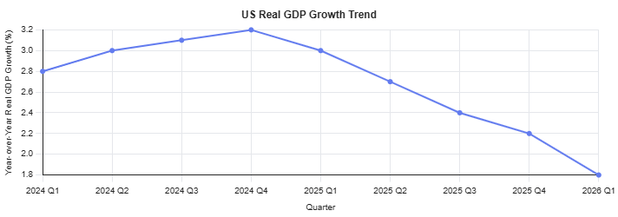
Quarterly Market Review
The Case for Diversification: Protecting Wealth in an Uncertain World
Heading into 2026, market sentiment resembled a delicate balancing act, with optimism about growth tempered by concern over inflation and rates potentially disrupting the balance. As the quarter unfolded, markets were reminded that economic transitions are rarely smooth. The quarter felt worse than it actually was, underscoring the importance of discipline, diversification, and long-term perspective during periods of uncertainty.
The economy can feel uncomfortable as it stabilizes because expectations often shift toward worry before the data shows signs of real deterioration, particularly during late-cycle transitions. Overall, the first quarter was a time of resetting those expectations. Heading into the second quarter, the picture is clearer, though challenges remain.
Most importantly, well-constructed portfolios and financial plans are made for periods like this.
Megan Nichols, CFP®
Financial Advisor
Cooling, Not Collapsing
First quarter data for 2026 suggests the economy is slowing gradually, akin to a late-cycle slowdown rather than a sharp downturn. US growth is slowing from above-trend levels, the labor market is softer but still functional, and consumer spending remains supported, though uneven.
Source: U.S. Bureau of Economic Analysis.

Slide 6
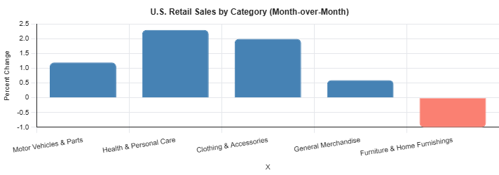
Quarterly Market Review
The Case for Diversification: Protecting Wealth in an Uncertain World
The Atlanta Fed’s GDPNow estimate for 1Q 2026 real GDP growth indicates a slowdown to roughly 1.6%–2.0%, down from above 3% in late 2025, reflecting softer consumer spending growth and slower inventory accumulation rather than widespread economic stress.
Payroll growth was well below prior-year levels but sufficient to keep the unemployment rate stable. In March, employers added 178,000 jobs, while the unemployment rate held near 4.3%, underscoring a labor market that is cooling but not contracting.
Source: US Census Bureau (Advance Monthly Retail Trade Report, February 2026)
Retail sales rebounded late in the quarter, driven by motor vehicles, health‑related spending, and discretionary categories, as higher‑ticket items like furniture lagged. This pattern suggests elevated prices and borrowing costs are influencing where households are willing to spend.
Cooling demand, normalizing labor conditions, and reduced excesses often precede longer-term economic stability, though they can feel uncomfortable in real time.

Slide 7
Quarterly Market Review
The Case for Diversification: Protecting Wealth in an Uncertain World
The Fed’s Narrow Path
Entering 2026, the Federal Reserve was facing a growing tension between its two, sometimes conflicting, mandates: 1) promoting a strong job market and 2) stable prices.
On one side, inflation had cooled meaningfully from earlier peaks, and price stability was improving, though not decisively achieved. Goods had largely normalized, but services (particularly housing-related costs, insurance, and healthcare) remained sticky.
On the other side, the labor market was no longer overheating as hiring had slowed, job openings had declined, and wage growth was moderating. However, unemployment remained low by historical standards, layoffs were limited, and firms were generally reluctant to shed workers. Neither mandate was flashing red, but both were drifting toward discomfort at the same time.
After reviewing first-quarter data, the Fed expects slower growth and a longer path back to their 2% inflation target, keeping rates elevated for now. Since investors entered the year expecting multiple rate decreases in 2026, expectations were adjusted and it was felt throughout markets.
Importantly, history suggests these environments often resolve not through abrupt policy moves, but through time and normalization. While rate cuts may come slowly and unevenly, higher-for-longer does not necessarily mean higher forever.
Your Portfolio Was Made for This
Equity markets posted solid gains in 2025, thanks to resilient economic growth, strong corporate profits, and continued artificial intelligence enthusiasm. The volatility markets experienced to start the year reflects a normal transitionary phase of the economic cycle.
Markets tend to adjust to changing economic conditions ahead of official data and headlines, and first-quarter performance reflected a recalibration of expectations rather than a reassessment of long‑term fundamentals.
By the time concerns dominated the news cycle, asset prices were already incorporating slower growth assumptions, more measured expectations for interest rate cuts, and greater differentiation across regions, sectors, and styles. This forward-looking nature explains why volatility increased without translating into broad market breakdowns.
Markets reallocated capital toward areas better aligned with the environment, favoring companies with durable earnings, pricing power, and balance sheet strength, while reassessing valuation and growth assumptions elsewhere.

Slide 8
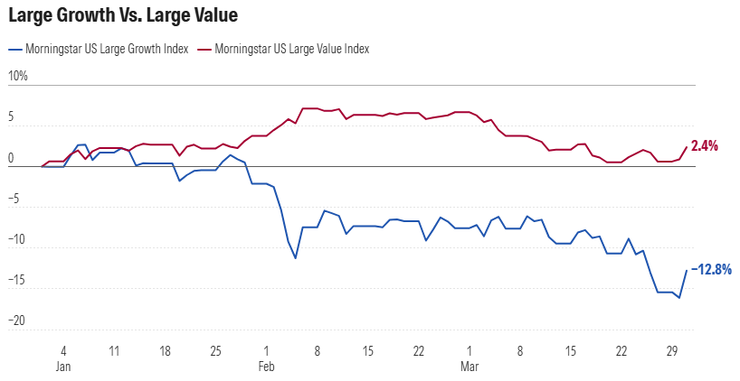
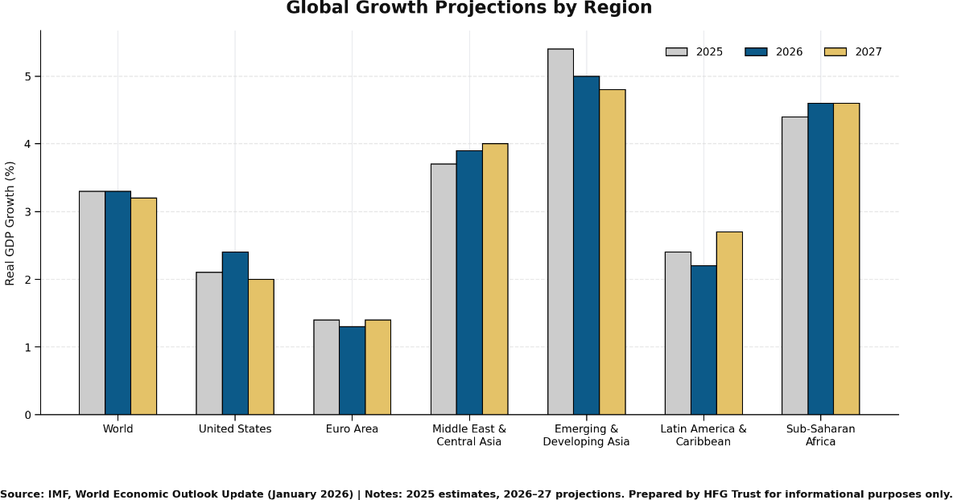
Quarterly Market Review
The Case for Diversification: Protecting Wealth in an Uncertain World
Global economic growth remains positive overall, but it is increasingly uneven across regions. The world economy is still expanding at a moderate pace, supported by technology investment, services demand, and fiscal support, particularly in the United States and parts of Asia.
In contrast, Europe continues to lag, constrained by higher energy costs, weaker manufacturing activity, and long‑standing structural challenges. Many emerging markets are growing faster on average, but outcomes vary widely depending on exposure to commodities, debt levels, and financial conditions. Geopolitical tensions, trade fragmentation, and energy price volatility have further amplified these differences, leading to a global environment where growth persists, but not uniformly, and with increasing dispersion across countries and regions.
Periods of transition tend to reward diversified portfolios built with both growth and income in mind. As markets adapt to a more uneven global backdrop, income-generating assets and diversification have re‑emerged as important contributors to resilience and long‑term results. A well‑designed financial plan recognizes market volatility as an inevitable part of the journey and is built to withstand a wide range of economic and market environments.
Source: Morningstar. Data as of March 31, 2026
Remaining focused on long‑term objectives, supported by diversified portfolios and thoughtful financial planning, remains the most reliable way to navigate periods of uncertainty.
Source: IMF, World Economic Outlook Update (January 2026) | Notes: 2025 estimates, 2026-2027 projections. Prepared by HFG Trust for informational purposes only.

Slide 9
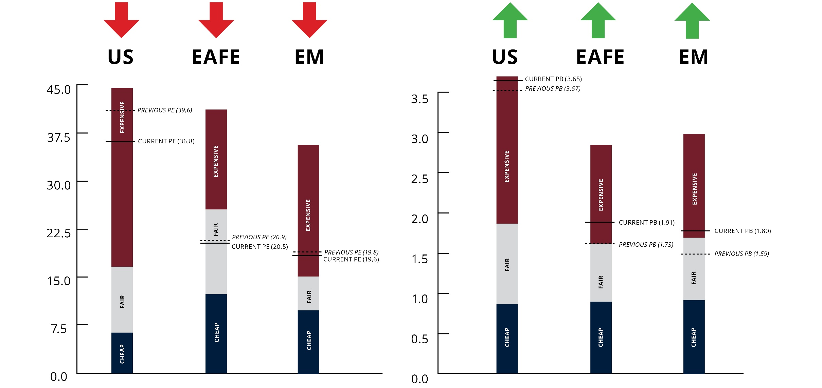
Global Valuations
9
What is the Investment Climate?
Price-to-Earnings (CAPE)
Price-to-Book Value
As of 3/31/2026
As of 3/31/2026
Cyclically Adjusted Price-to-Earnings or “CAPE” is a valuation metric, where the current market price is divided by the last ten years of average earnings (adjusted for inflation). The price you pay is what you get, and by utilizing average earnings over a longer period (10 years), we can put into perspective whether the current market price is trending toward expensive, undervalued, or fairly valued historically.

Slide 10
US Stocks
Returns (USD), 1st Quarter 2026
The US equity market posted negative returns for the quarter and underperformed both non-US developed and emerging markets.
Value outperformed growth.
Small caps outperformed large caps.
REIT indices outperformed equity market indices.
Ranked Returns (%)
Small Value
Large Value
Small Cap
Small Growth
Marketwide
Large Cap
Large Growth
World Market Capitalization
Periodic Returns (%)
 |  | ANNUALIZED | ANNUALIZED | * Annualized
Asset Class | QTR | 1 Year | 3 Years | 5 Years | 10 Years | 15 Years | 20 Years
Small Value | 4.96 | 28.09 | 13.80 | 5.79 | 9.61 | 8.62 | 6.98
Large Value | 2.10 | 15.87 | 14.31 | 9.43 | 10.58 | 10.47 | 8.12
Small Cap | 0.89 | 25.72 | 13.05 | 3.77 | 9.88 | 8.98 | 7.54
Small Growth | -2.81 | 23.58 | 12.27 | 1.62 | 9.79 | 9.09 | 7.88
Marketwide | -3.96 | 18.09 | 17.86 | 10.87 | 13.72 | 12.81 | 10.26
Large Cap | -4.18 | 17.74 | 18.14 | 11.34 | 13.97 | 13.09 | 10.46
Large Growth | -9.78 | 18.81 | 21.18 | 12.76 | 16.83 | 15.33 | 12.48
US Market
$62.6 trillion
Past performance is not a guarantee of future results. Indices are not available for direct investment. Index performance does not reflect the expenses associated with the management of an actual portfolio. Market segment (index representation) as follows: Marketwide (Russell 3000 Index), Large Cap (Russell 1000 Index), Large Value (Russell 1000 Value Index), Large Growth (Russell 1000 Growth Index), Small Cap (Russell 2000 Index), Small Value (Russell 2000 Value Index), and Small Growth (Russell 2000 Growth Index). World Market Cap represented by Russell 3000 Index, MSCI World ex USA IMI Index, and MSCI Emerging Markets IMI Index. Russell 3000 Index is used as the proxy for the US market. Dow Jones US Select REIT Index used as proxy for the US REIT market. MSCI data © MSCI 2026, all rights reserved. Frank Russell Company is the source and owner of the trademarks, service marks, and copyrights related to the Russell Indexes.

Slide 11
International Developed Stocks
Firm Logo
Returns (USD), 1st Quarter 2026
All three regions—emerging, developed international, and U.S. stocks—posted negative returns for the quarter, with emerging markets performing best, followed by developed markets outside the U.S., and U.S. stocks finishing last.
Value outperformed growth.
Small caps outperformed large caps.
Ranked Returns (%)
Value
Small Cap
Marketwide
Large Cap
Growth
Value
Large Cap
Growth
World Market Capitalization
Periodic Returns (%)
Small Cap
 |  | ANNUALIZED | ANNUALIZED | * Annualized
Asset Class | QTR | 1 Year | 3 Years | 5 Years | 10 Years | 15 Years | 20 Years
Value | 2.50 | 32.19 | 20.37 | 12.69 | 9.71 | 6.50 | 5.14
Small Cap | -0.37 | 29.19 | 13.77 | 5.40 | 7.95 | 6.56 | 5.49
Marketwide | -0.86 | 23.84 | 14.23 | 7.96 | 8.56 | 6.29 | 5.25
Large Cap | -0.94 | 22.99 | 14.30 | 8.40 | 8.66 | 6.26 | 5.17
Growth | -4.60 | 13.95 | 8.34 | 3.99 | 7.31 | 5.79 | 5.01
International Developed Markets
$26.6 trillion
Past performance is not a guarantee of future results. Indices are not available for direct investment. Index performance does not reflect the expenses associated with the management of an actual portfolio. Market segment (index representation) as follows: Marketwide (MSCI World ex USA IMI Index), Large Cap (MSCI World ex USA Index), Small Cap (MSCI World ex USA Small Cap Index), Value (MSCI World ex USA Value Index), and Growth (MSCI World ex USA Growth Index). All index returns are net of withholding tax on dividends. World Market Cap represented by Russell 3000 Index, MSCI World ex USA IMI Index, and MSCI Emerging Markets IMI Index. MSCI World ex USA IMI Index is used as the proxy for the International Developed market. MSCI data © MSCI 2026, all rights reserved. Frank Russell Company is the source and owner of the trademarks, service marks, and copyrights related to the Russell Indexes.

Slide 12
Emerging Markets Stocks
Returns (USD), 1st Quarter 2026
Emerging Markets posted negative returns for the quarter and outperformed both US and non-US developed markets.
Value outperformed growth.
Small caps underperformed large caps.
Ranked Returns (%)
Value
Large Cap
Marketwide
Small Cap
Growth
World Market Capitalization
Periodic Returns (%)
 |  | ANNUALIZED | ANNUALIZED | * Annualized
Asset Class | QTR | 1 Year | 3 Years | 5 Years | 10 Years | 15 Years | 20 Years
Value | 1.10 | 28.65 | 15.52 | 6.14 | 7.27 | 2.70 | 5.10
Large Cap | -0.17 | 29.55 | 14.84 | 3.69 | 7.80 | 3.67 | 5.38
Marketwide | -0.24 | 28.88 | 14.67 | 4.03 | 7.82 | 3.75 | 5.55
Small Cap | -0.74 | 24.55 | 13.74 | 6.68 | 8.13 | 4.44 | 6.59
Growth | -1.43 | 30.21 | 14.11 | 1.36 | 8.22 | 4.53 | 5.57
Emerging Markets
$11.7 trillion
Past performance is not a guarantee of future results. Indices are not available for direct investment. Index performance does not reflect the expenses associated with the management of an actual portfolio. Market segment (index representation) as follows: Marketwide (MSCI Emerging Markets IMI Index), Large Cap (MSCI Emerging Markets Index), Small Cap (MSCI Emerging Markets Small Cap Index), Value (MSCI Emerging Markets Value Index), and Growth (MSCI Emerging Markets Growth Index). All index returns are net of withholding tax on dividends. World Market Cap represented by Russell 3000 Index, MSCI World ex USA IMI Index, and MSCI Emerging Markets IMI Index. MSCI Emerging Markets IMI Index used as the proxy for the emerging market portion of the market. MSCI data © MSCI 2026, all rights reserved. Frank Russell Company is the source and owner of the trademarks, service marks, and copyrights related to the Russell Indexes.

Slide 13
Fixed Income
Returns (USD), 1st Quarter 2026
Within the US Treasury market, interest rates increased during the quarter.
On the short end of the yield curve, the
1-Month US Treasury Bill yield remained unchanged at 3.74%. The 1-Year US Treasury Bill yield increased 20 basis points (bps) to 3.68%. The yield on the 2-Year US Treasury Note increased 32 bps to 3.79%.
The yield on the 5-Year US Treasury Note increased 19 bps to 3.92%. The yield on the 10-Year US Treasury Note increased 12 bps to 4.30%. The yield on the 30-Year US Treasury Bond increased 4 bps to 4.88%.
In terms of total returns, short-term US Treasury bonds returned +0.15% and intermediate-term US treasury bonds returned +0.05%. Short-term corporate bonds returned +0.09% and intermediate-term corporate bonds returned -0.22%.¹
The total returns for short- and intermediate-term municipal bonds were +0.43% and -0.57%, respectively. Within the municipal fixed income market, general obligation bonds returned -0.32% while revenue bonds returned -0.13%.²
US Treasury Yield Curve (%)
Bond Yield Across Issuers (%)
Periodic Returns (%)
 |  | ANNUALIZED | ANNUALIZED | Annualized
Asset Class | QTR | 1 Year | 3 Years | 5 Years | 10 Years | 15 Years | 20 Years
ICE BofA US 3-Month Treasury Bill Index | 0.85 | 4.00 | 4.74 | 3.34 | 2.26 | 1.53 | 1.70
ICE BofA 1-Year US Treasury Note Index | 0.59 | 3.67 | 4.32 | 2.58 | 2.05 | 1.47 | 1.90
Bloomberg U.S. TIPS Index | 0.26 | 3.00 | 3.18 | 1.48 | 2.66 | 2.78 | 3.64
FTSE World Government Bond Index 1-5 Years (hedged to USD) | 0.23 | 3.88 | 4.35 | 1.92 | 1.99 | 1.95 | 2.49
Bloomberg U.S. Aggregate Bond Index | -0.05 | 4.35 | 3.63 | 0.31 | 1.70 | 2.39 | 3.28
Bloomberg Municipal Bond Index | -0.18 | 4.29 | 2.87 | 0.84 | 2.16 | 3.29 | 3.50
Bloomberg U.S. Government Bond Index Long | -0.40 | 0.49 | -1.47 | -4.55 | -0.77 | 2.55 | 3.47
FTSE World Government Bond Index 1-5 Years | -0.48 | 5.15 | 3.55 | 0.26 | 0.84 | 0.14 | 1.81
Bloomberg U.S. High Yield Corporate Bond Index | -0.50 | 7.01 | 8.60 | 4.23 | 6.12 | 5.72 | 6.56
1. Bloomberg US Treasury and US Corporate Bond Indices
2. Bloomberg Municipal Bond Index
One basis point (bps) equals 0.01%. Past performance is not a guarantee of future results. Indices are not available for direct investment. Index performance does not reflect the expenses associated with the management of an actual portfolio. Yield curve data from Federal Reserve. State and local bonds and the Yield to Worst are from the S&P National AMT-Free Municipal Bond Index. AAA-AA Corporates represent the ICE BofA US Corporates, AA-AAA rated. A-BBB Corporates represent the ICE BofA Corporates, BBB-A rated. Bloomberg data provided by Bloomberg. US long-term bonds, bills, inflation, and fixed income factor data © Stocks, Bonds, Bills, and Inflation (SBBI) Yearbook™, Ibbotson Associates, Chicago (annually updated work by Roger G. Ibbotson and Rex A. Sinquefield). FTSE fixed income indices © 2026 FTSE Fixed Income LLC, all rights reserved. ICE BofA index data © 2026 ICE Data Indices, LLC. S&P data © 2026 S&P Dow Jones Indices LLC, a division of S&P Global. All rights reserved. Bloomberg data provided by Bloomberg.

Slide 14
Real Estate Investment Trusts
Returns (USD), 1st Quarter 2026
US real estate investment trusts outperformed non-US REITs during the quarter.
Ranked Returns (%)
US REITs
Global ex US REITs
Total Value of REIT Stocks
Periodic Returns (%)
 |  | ANNUALIZED | ANNUALIZED | * Annualized
Asset Class | QTR | 1 Year | 3 Years | 5 Years | 10 Years | 15 Years | 20 Years
US REITs | 4.64 | 7.23 | 9.15 | 5.59 | 4.76 | 7.12 | 5.46
Global ex US REITs | -7.88 | 10.68 | 3.99 | -0.99 | 0.95 | 2.79 | 2.21
US
$1,107 billion
100 REITs
70%
US
30%
Global ex US
Global ex US
$467 billion
277 REITs
(26 other countries)
Past performance is not a guarantee of future results. Indices are not available for direct investment. Index performance does not reflect the expenses associated with the management of an actual portfolio. Number of REIT stocks and total value based on the two indices. All index returns are net of withholding tax on dividends. Total value of REIT stocks represented by Dow Jones US Select REIT Index and the S&P Global ex US REIT Index. Dow Jones US Select REIT Index used as proxy for the US market, and S&P Global ex US REIT Index used as proxy for the World ex US market. Dow Jones and S&P data © 2026 S&P Dow Jones Indices LLC, a division of S&P Global. All rights reserved.

